Slide 1
Testing

Slide 2
Agenda
What is Testing?
Software Testing Concepts
White Box Testing Techniques
Black Box Testing Techniques
White Box vs Black Box Testing
Unit Testing
End-to-End Testing
E2E vs Unit Testing
Mocking
Discussion and Lab time

Slide 3
What is Testing?
Process of evaluating software to detect differences between expected and actual results.
Ensures software quality, reliability, and security.
Notes:
Why do we need testing? → To catch errors early, improve reliability, and reduce costs.
Who performs testing? → Developers (unit testing), testers (QA), and users (UAT - User Acceptance Testing).

Slide 4
White Box vs Black Box Testing
White Box Testing
(Code Focused):
Testing with knowledge of the internal code.
Focuses on internal logic and code structure
Ex. Unit Testing
Black Box Testing
(User Focused):
Focuses on input and output without looking at internal code.
Based on specifications and user requirements.
Ex. End to End Testing
Notes:
Who does white box testing? → Usually developers.
Who does black box testing? → QA engineers
These are software testing concepts or techniques

Slide 5
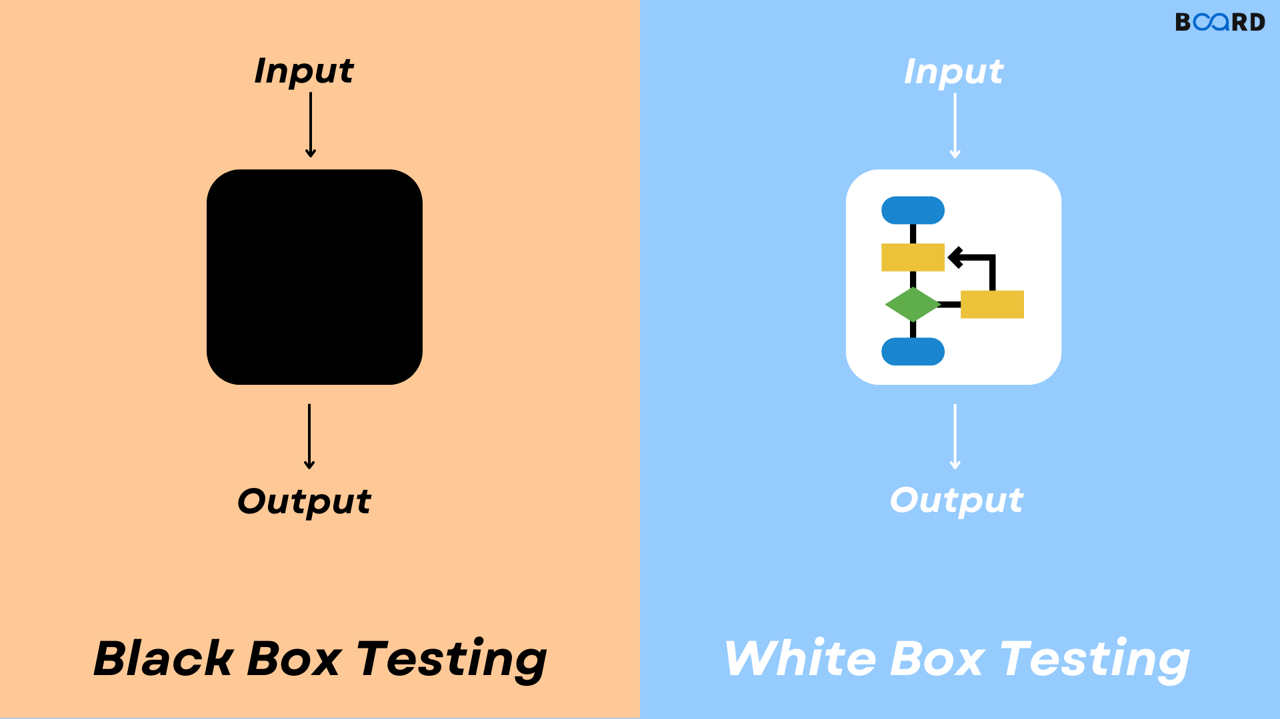
Image source: https://www.boardinfinity.com/blog/white-box-vs-black-box/

Slide 6
White Box Testing Techniques
Statement Coverage: Ensuring every line of code executes at least once.
Branch Coverage: Ensuring every decision point is tested. (if/else)
Path Coverage: Ensuring every possible execution path is tested.
Statement Coverage Example:
def add(a, b):
if a < 0 or b < 0:
return 0
return a + b
assert add(2, 3) == 5
assert add(-1, 3) == 0
assert add(-2, -3) == 0
print("All tests passed!")
Notes:
Do we always need 100% coverage? → Not always, but higher coverage means better-tested code.

Slide 7
Black Box Testing Techniques
Equivalence Partitioning: Grouping inputs into valid and invalid sets.
Boundary Value Analysis: Testing at the edges of input ranges.
State Transition Testing: Checking valid state changes.
Boundary value analysis example:
def is_valid_age(age):
return 18 <= age <= 60
assert is_valid_age(18) == True assert is_valid_age(60) == True assert is_valid_age(17) == False assert is_valid_age(61) == False
Notes:
Why test boundary values? → Bugs often appear at limits (e.g., off-by-one errors).
Difference between boundary value analysis w el statement could be confusing here just focus on that in the black box, dont know the internal code we just know that the function takes in age and return true or false according to a specific age range (Tester doesn't know how it is implemented)
How does black box testing help usability? → It mimics real-world user interaction.

Slide 8
White Box vs Black Box Testing
def add(a, b):
return a + b
assert add(2, 3) == 5
def login(username, password):
pass
assert login("user", "correct_password") == "Login Successful"

Slide 9
Unit Testing
Unit testing verifies individual functions or components in isolation to ensure they work as expected.
Helps catch bugs early, improve code reliability, and make refactoring safer.
Popular frameworks
jest in js
unittest python
Notes:
Unit testing is an example of white box and we r focusing on it here

Slide 10
Unit Testing
class TestMathOperations(
unittest.TestCase):
def test_multiply(self):
assert multiply(2, 3) == 6
assert multiply(1, 5)== -5
if __name__ == '__main__':
unittest.main()
import unittest
def multiply(a, b):
return a * b
Notes:
Note: Second test fails

Slide 11
E2E Testing
E2E testing simulates real user interactions by testing the entire application flow from start to finish.
Ensures all components work together correctly, detecting integration issues and verifying system reliability.
Notes:
Example of black box testing concept
In E2E testing we mimic user interaction using code with no knowledge of the implementation we just know the inputs and outputs

Slide 12
End-to-End Testing [Example]
from selenium import webdriver
driver = webdriver.Chrome()
driver.get("https://example.com/login")
driver.find_element("name", "username").send_keys("testuser")
driver.find_element("name", "password").send_keys("password123")
driver.find_element("name", "login").click()
assert "Welcome" in driver.page_source
driver.quit()
Notes:
Code example shows testing login functionality on a website by:
finding username & password items on a page
Sending data to fill those
Clicking on login button
Checking by getting ‘Welcome’ in the resulting page

Slide 13
E2E vs Unit Testing
Unit Testing:
Tests individual components of the software in isolation.
Fast and reliable.
Catch small, isolated bugs
Example (functions test using python unit test or jest in js)
End-to-End (E2E) Testing:
Tests the entire system flow, including integration
Usually slow
Ensures all parts integrate together
Example (using Selenium for UI testing):

Slide 14
Mocking
Technique that replaces real objects with fake ones during testing.
Test different simulated scenarios to control outcome.
Helps isolate unit tests from dependencies.
Dependencies could be API calls, External Services, Databases, complex systems sensors readings, etc.
Notes:
Why mock API calls? → To avoid network delays and external failures in tests.
Why mock database? → Mocking database interactions ensures tests run quickly and without requiring a real database setup.
External Services → (e.g., payment gateways, authentication providers), mocks can simulate these services.
This code example shows isolating api calls and creating a mock for data returned
An object under test may have dependencies on other (complex) objects. This is why it is used in unit testing
In short, mocking is creating objects that simulate the behaviour of real objects.

Slide 15
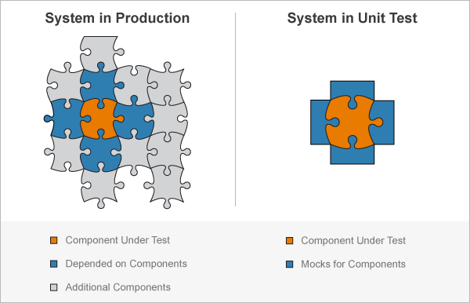
Mocking

Slide 16
Mocking [Code Example]
from unittest.mock import Mock
class AuthService:
def __init__(self, database):
self.database = database
def authenticate(self, user_id):
user = self.database.get_user(user_id)
if user and user.get("is_active"):
return "Authenticated"
return "Access Denied"
db_mock = Mock()
db_mock.get_user.return_value = {"id": 1, "name": "Ahmed"}
auth_service = AuthService(db_mock)
assert auth_service.authenticate(1) == "Authenticated"
Notes:
Here we changed the get_user behavior in the mock to return {"id": 1, "name": "Ahmed"} instead of fetching from the db We use this to test another functionality → authenticate

Slide 17
Mocking Payments with Stripe Test Mode
How do we test a payment system without actually charging a credit card?
Without Mocking:
App → Stripe API(Real) → Real Payment (Response)
With Mocking:
App → Stripe API (Test Mode) → No real interaction (Simulated Response)
Notes:
Solution: Use Stripe Test Mode to Mock Payments
Instead of making real payments, we mock Stripe’s behavior using test card numbers and simulated API responses

Slide 18
Discussion and Lab Time

